Slide 1
Introduction to machine learning
Session 19
Henry Lucky, S.Kom., M.Kom.

Slide 2
Learning Outcomes
Session 19
At the end of this session, students will be able to:
LO 5: Apply various learning algorithms for agents to solve problems

Slide 3
outline
Session 19
Introduction to Machine Learning
Solving specific problem
Categories of Machine Learning
Component of Machine Learning Algorithm

Slide 4
Introduction to machine learning
What is machine Learning?
Machine learning is the cornerstone of AI, considered fundamental by many experts.
AI applications are expected to possess machine learning capabilities to be deemed truly intelligent.
Simply being able to perform tasks like chess-playing doesn't signify intelligence; machine learning is essential for advanced abilities.
In essence, a chess-playing system lacking machine learning is akin to a basic computer program, lacking true intelligence.
So, what is machine learning?

Slide 5
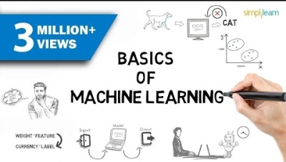
Introduction to Machine learning
What is machine learning?
What is Machine Learning?
Source: https://youtu.be/ukzFI9rgwfU

Slide 6
Introduction to machine learning
The Von Neumann machine
A computer architecture proposed by polymath in 1945 based on Sir Alan Turing’s work on Turing Machine.
The basic components of vNM which consists of:
  Central processing unit (CPU) – system brain consists of system control unit, basic arithmetic, and logical unit
  Memory unit - data and information storage
  Input and output units – data input (e.g. keyboard) and output (e.g. screen)

Slide 7
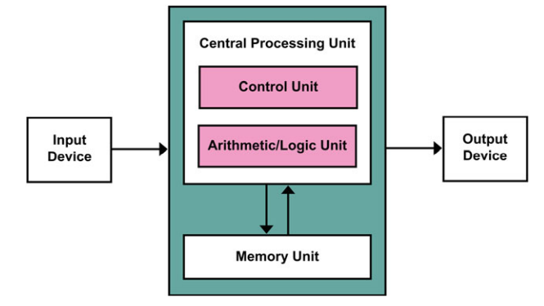
Introduction to machine learning
The Von Neumann machine

Slide 8
Introduction to machine learning
The Von Neumann machine
All computer systems that we use today; their basic architectures are all inherited from the blueprint of von Neumann Machine.
Are they intelligent machines? Why or why not?
Let’s look at two cases of computer systems in our daily activities.

Slide 9
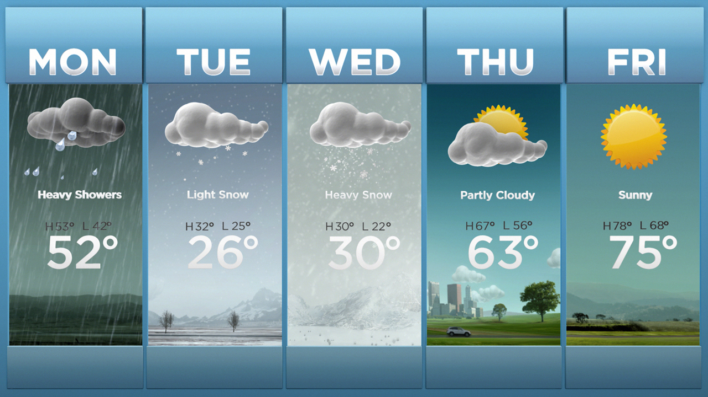
Introduction to machine learning
Case 1: Numerical Weather Prediction
Weather forecasting relies on Numerical Weather Prediction (NWP) systems, which utilize complex mathematical models and global weather observations.
NWP accurately predicts weather components like air pressure, temperature, humidity, and wind speed for up to 7 days into the future.
However, NWP lacks intelligence and cannot learn or improve autonomously.
The system doesn’t have the ability to adapt or learn from new information.

Slide 10
Introduction to machine learning
Case 2: Alphago
AlphaGo, developed by DeepMind Technologies and acquired by Google in 2015, is an AI-based computer program designed to play the board game Go.
AlphaGo's ability to learn and improve its gameplay distinguishes it from standard von Neumann Machines.
Similar to playing against an experienced chess master, AlphaGo continuously adapts its strategies based on past experiences and opponent moves.
This is what we call machine learning – intelligence.
Notes:
Unlike traditional board games like chess, Go requires strategic placement of stones rather than moving pieces across the board.

Slide 11
Introduction to machine learning
Applications
Healthcare:
  Diagnostics: Predictive models for disease detection (e.g., cancer, diabetes).
  Personalized Medicine: Treatment plans based on patient data.
  Medical Imaging: Automated analysis of X-rays, MRIs.
Finance:
  Fraud Detection: Identifying fraudulent transactions.
  Algorithmic Trading: Automated, high-frequency trading strategies.
  Credit Scoring: Assessing creditworthiness using ML models.

Slide 12
Introduction to machine learning
Applications
Retail:
  Recommendation Systems: Personalized product recommendations (e.g., Amazon, Netflix).
  Inventory Management: Predictive analytics for stock optimization.
  Customer Segmentation: Targeted marketing based on customer behaviour.
Other Advanced Applications:
  Autonomous vehicle, Natural Language Processing, Computer Vision
  Smart Cities, Agriculture, Education
  etc.

Slide 13
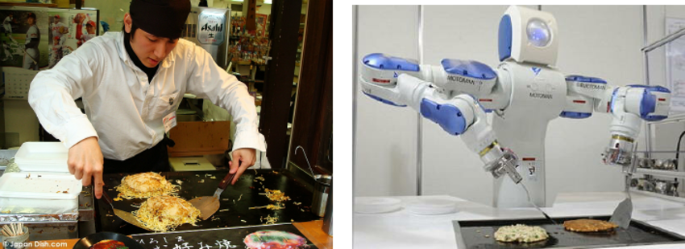
Solving specific problem
problem
How can we solve a specific problems?
  We need to write a program that encodes a set of rules that are useful to solve the problem
Source images: Alessandro Pieropan, Action Recognition for Robot Learning

Slide 14
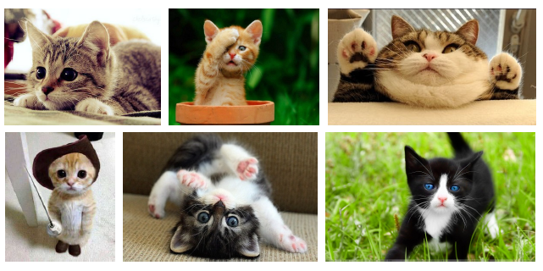
Solving specific problem
problem
How can we solve a specific problems?
  We need to write a program that encodes a set of rules that are useful to solve the problem
  In many cases is very difficult to specify those rules, e.g. given a picture determine whether there is a cat in the image
Source images: Raquel Urtasun, Richard Zemmel and Sanja Findler, Introduction to Machine learning

Slide 15
Solving specific problem
problem
Learning Systems are not directly programmed to solve a problem, instead develop own program based on:
  Examples of how they should behave
  From trial-and-error experience trying to solve the problem
Learning simply means incorporating information from the training examples into the system

Slide 16
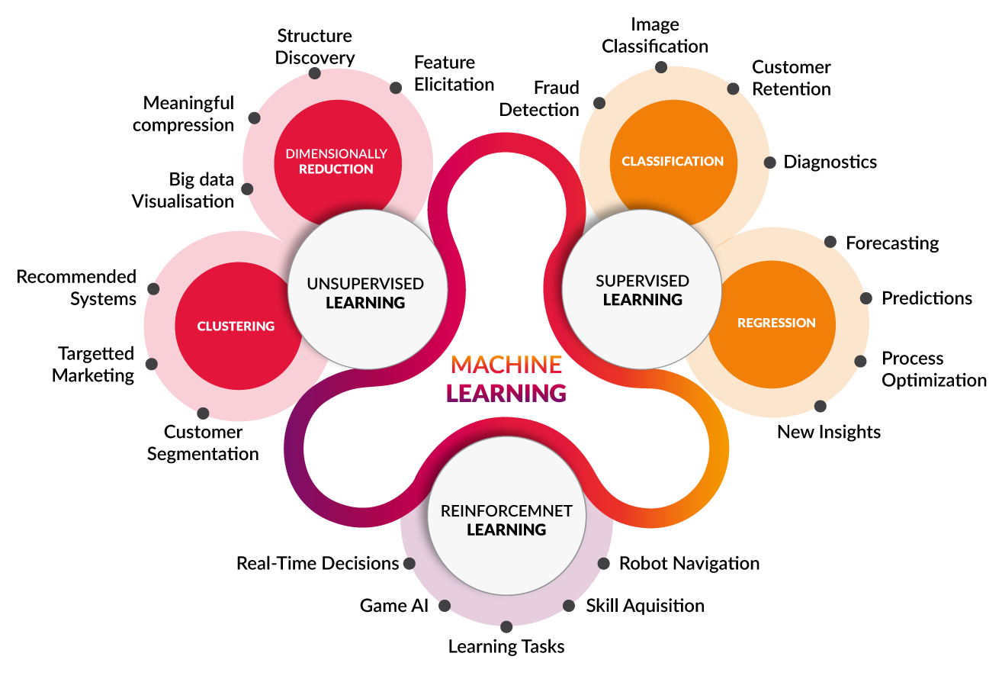
Categories of Machine Learning
Pillars of Machine learning
REINFORCEMENT
Source: https://towardsdatascience.com/coding-deep-learning-for-beginners-types-of-machine-learning-b9e651e1ed9d

Slide 17
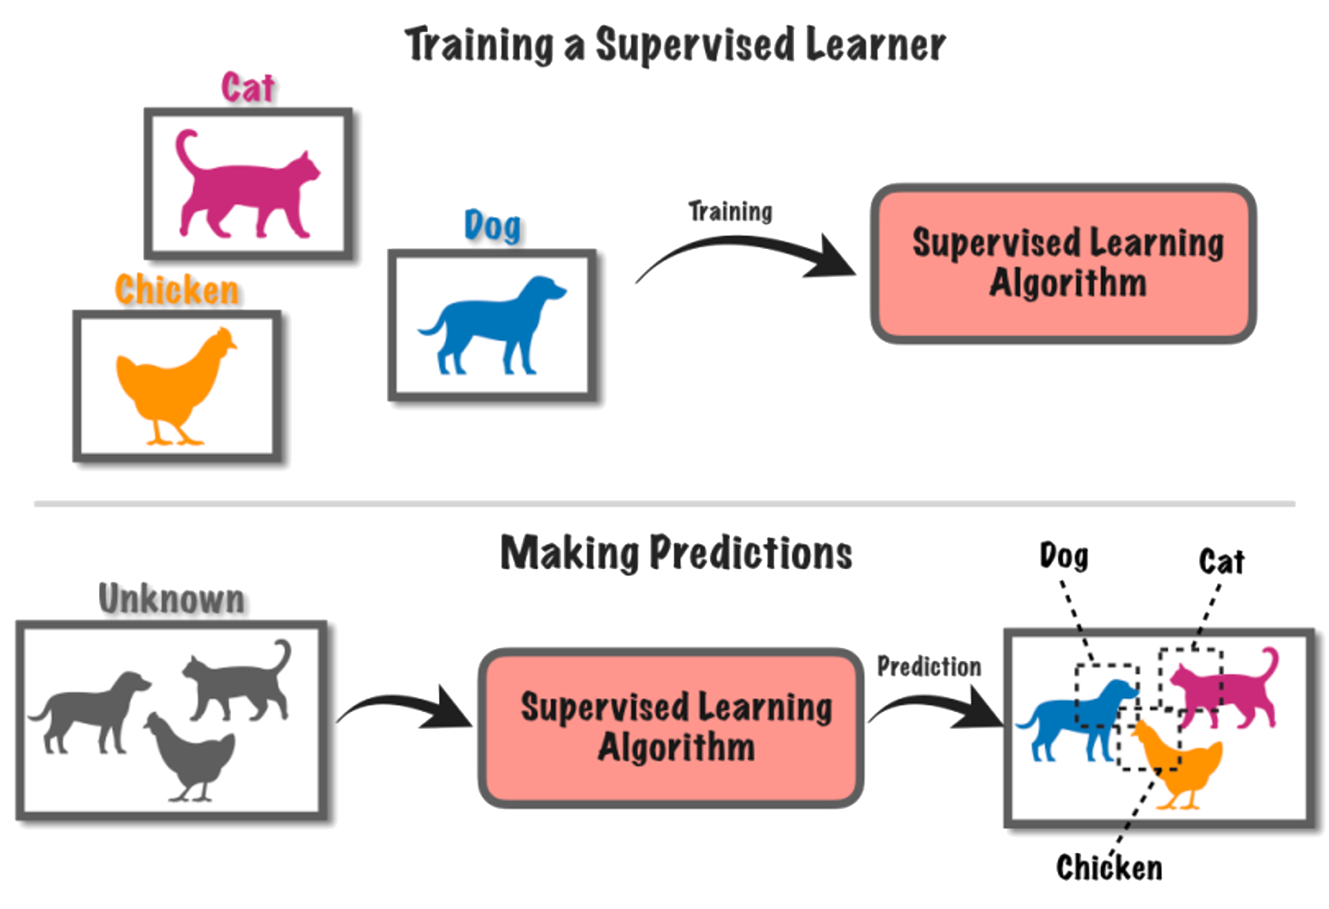
Categories of Machine Learning
Supervised Learning
Supervised Learning involves learning from labeled data, where the algorithm is trained on input-output pairs.
Common supervised learning tasks include classification (predicting categories) and regression (predicting continuous values).
Source: https://alanjeffares.wordpress.com/2018/07/24/test/

Slide 18
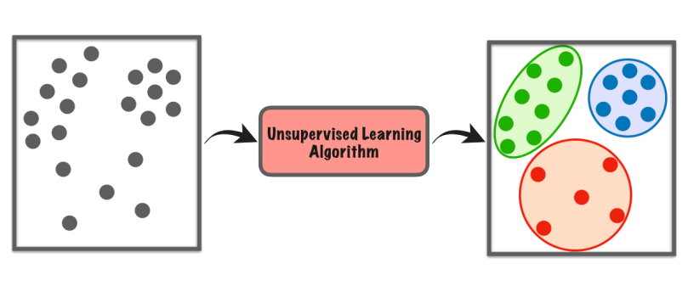
Categories of Machine Learning
Unsupervised learning
Unlike supervised Learning, it doesn't rely on labeled data for training.
Instead, it explores patterns and structures within unlabeled data.
Source: https://alanjeffares.wordpress.com/2018/07/24/test/
It aim to uncover hidden patterns, groupings, or relationships in data.
Common unsupervised learning tasks include clustering, dimensionality reduction, and anomaly detection.

Slide 19
Categories of Machine Learning
Reinforcement learning
In reinforcement learning, an agent learns to make decisions by interacting with an environment.
Unlike other types of learning, reinforcement learning doesn't need labeled or unlabeled data - it learns from trial and error.
The goal for the agent is to learn the best actions to take in different situations to maximize rewards.
It's like teaching a pet tricks: they learn what actions lead to treats and repeat those actions.
Even ChatGPT is built using some kind of reinforcement learning!
Notes:
ChatGPT used Reinforcement Learning with Human Feedback (RLHF): a technique to align an intelligent agent to human preferences.

Slide 20

Categories of Machine Learning
Examples: A.I. Learns to play Flappy Bird

Slide 21
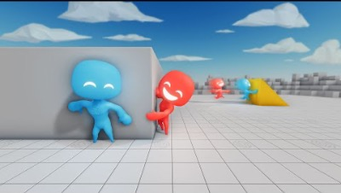
Categories of Machine Learning
Examples: Multi-Agent Hide and Seek

Slide 22
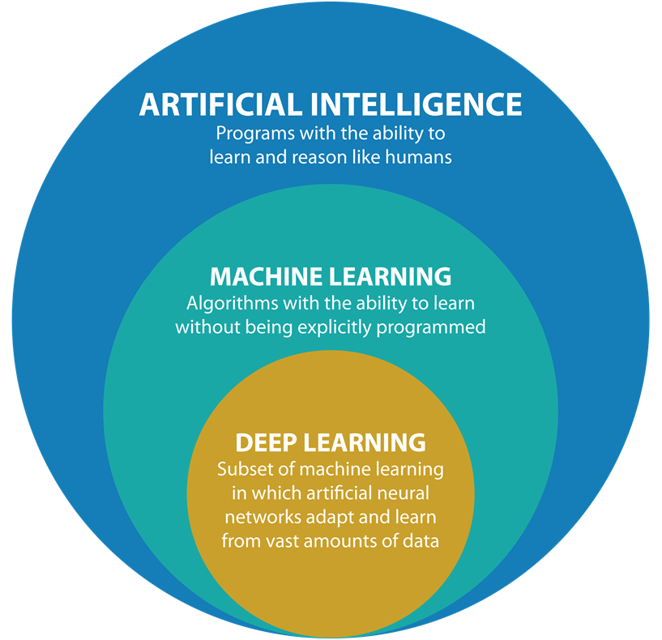
Categories of Machine Learning
AI vs ML vs DL

Slide 23
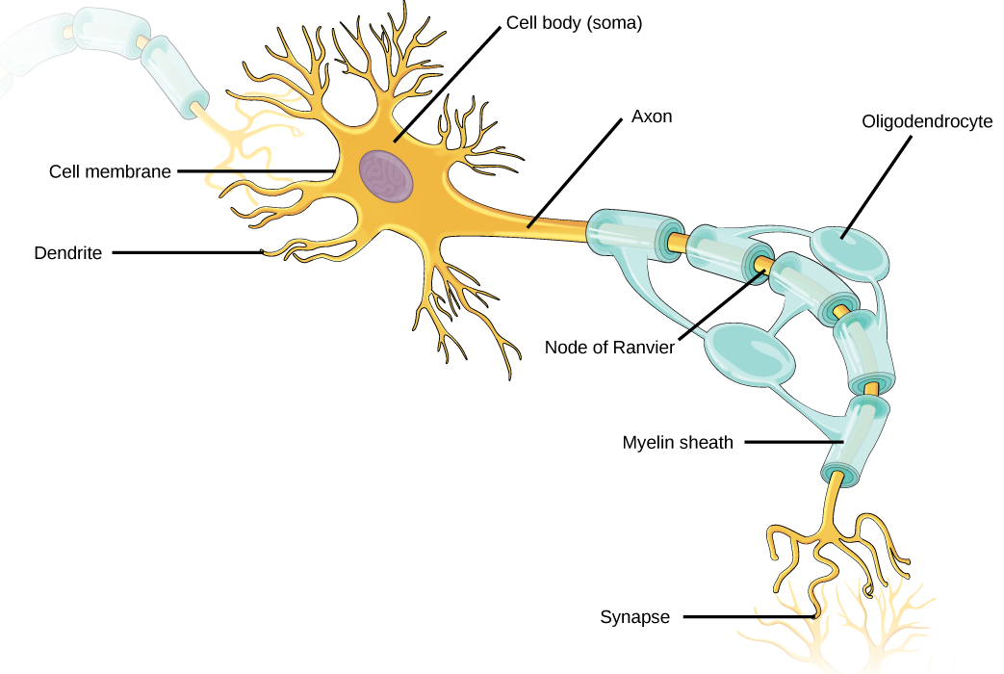
Deep learning
Neuron
A human brain is a complex organization of a cell called as neuron.
A neuron can process information by running this process:
Receive signals from other neurons via dendrites,
Tweak the signals in its cell body,
Send new signals to other neurons via synaptic terminals

Slide 24
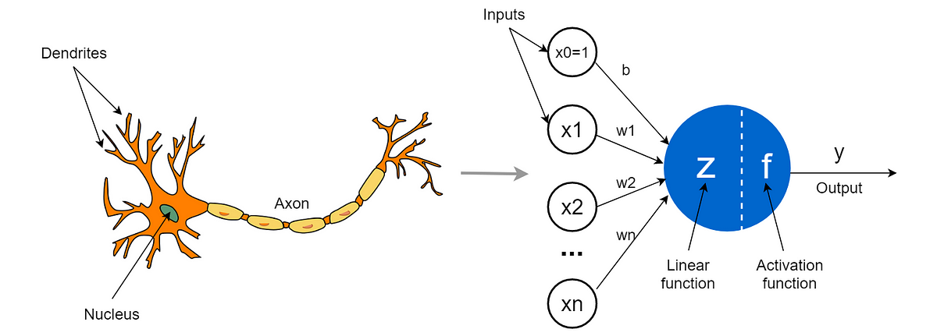
Deep learning
Artificial Neural Network
ANNs are a computational model inspired by the structure and function of biological neural networks in the human brain.
Here is the comparation between biological neuron and artificial neuron:

Slide 25
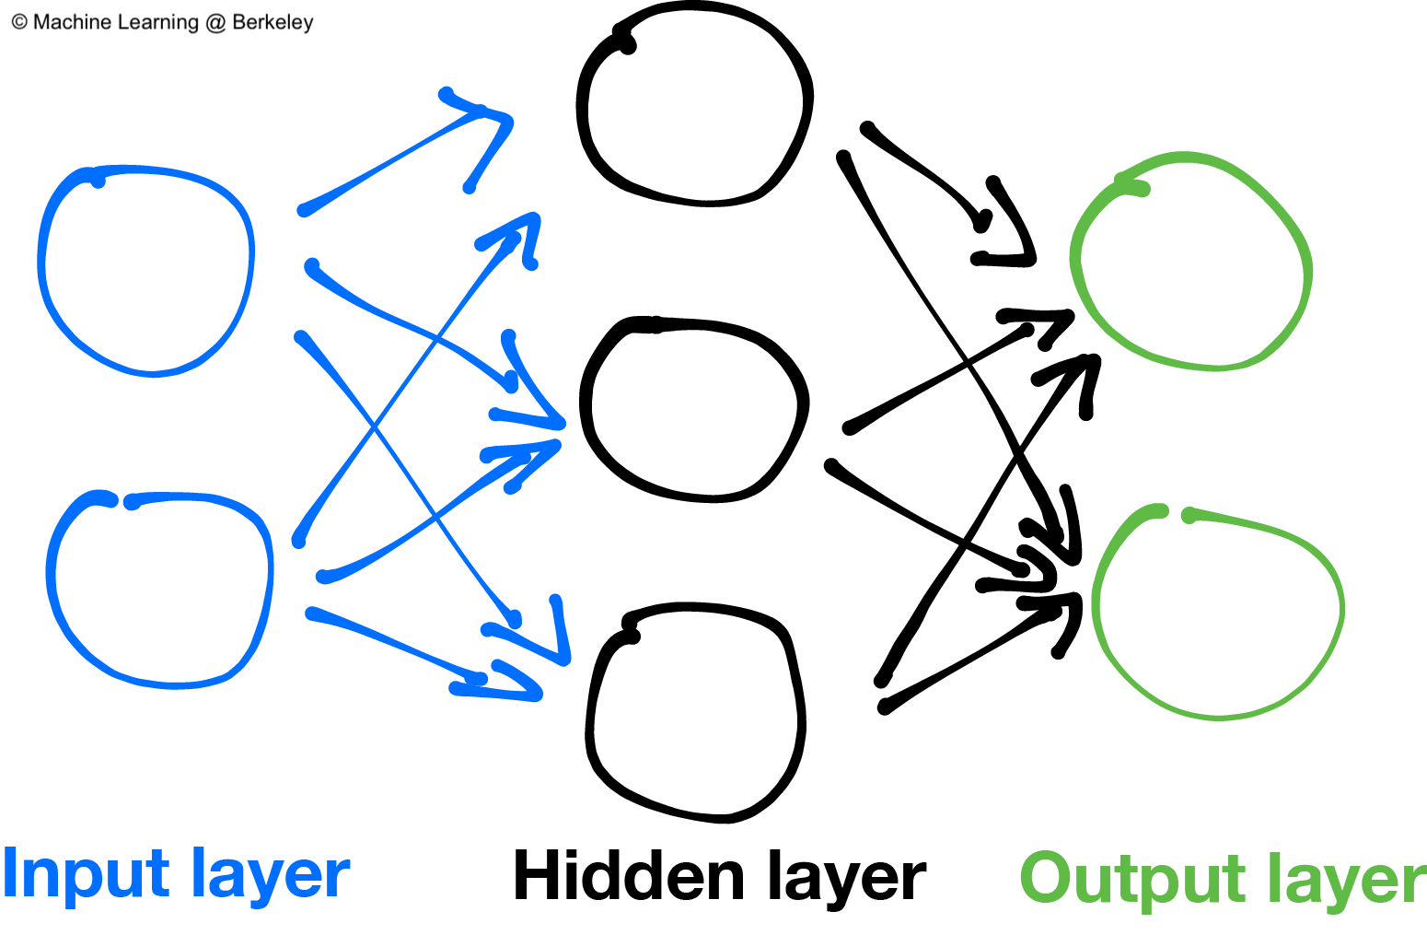
Deep learning
Artificial Neural Network
In ANN, the neurons are interconnected and organized in layers.
Information flows through the network from input layers to output layers.
Typical ANN has 3 layers: Input, Hidden and Output layers.

Slide 26
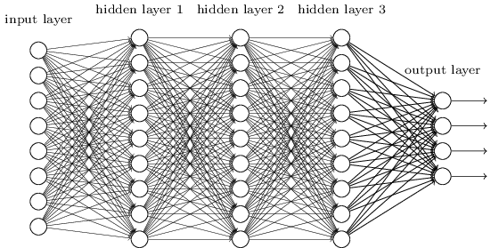
Deep learning
Definition
Deep learning revolves around ANN with multiple hidden layers (hence "deep"),
Multiple hidden layers can learn complex patterns in data.
It can automatically learn features from raw data, eliminating the need for manual feature extraction.

Slide 27
Component of Machine Learning Algorithm
The procedure of machine learning
Define the problem to be solved
Collect and/or labeled data
Choose an algorithm class
Choose an optimization metric for learning the model
Choose a metric for evaluating the model.

Slide 28
Case study
3 Machine learning methods
The 3 learning methods in machine learning are always integrated and mixed with our daily learning activities, including:
  Attending lectures;
  Reading books and papers;
  Completing assignments and exercises;
  Participating in group discussions;
  Completing term tests and quizzes;
  Study and revision;
Identify the learning methods involved in each activity above and give the reasoning!

Slide 29
References
Session 19
Peter Norvig, Stuart Russel. (2021). Artificial Intelligence: A Modern Approach. Pearson. London. ISBN: 978-1292401133. Ch. 19-20.

